Slide 1
Task 4

Slide 2
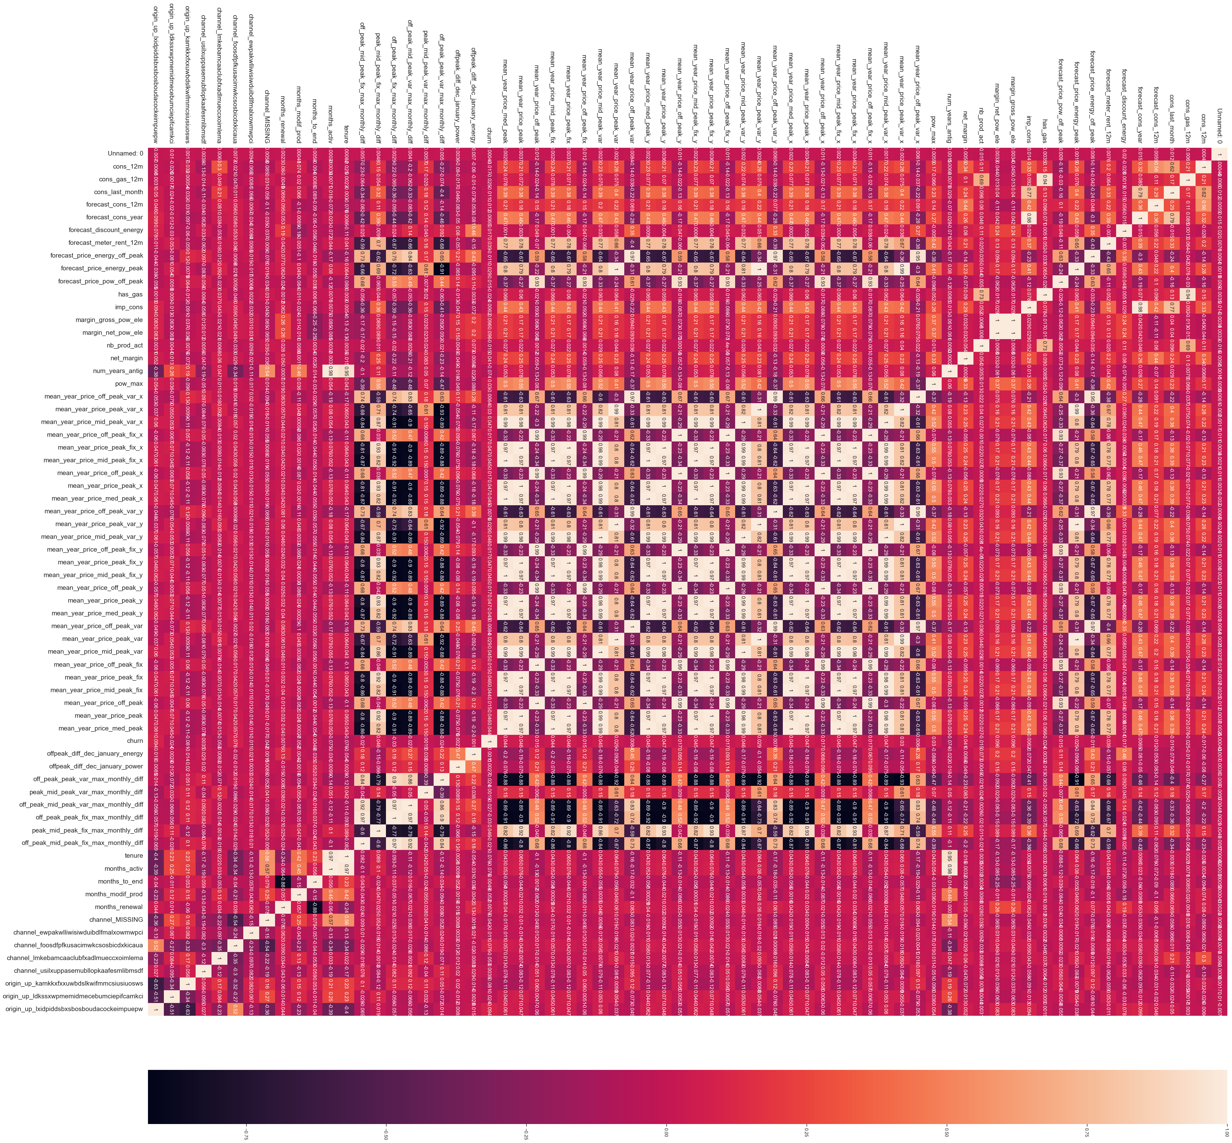
Correlation between Different Features

Slide 3
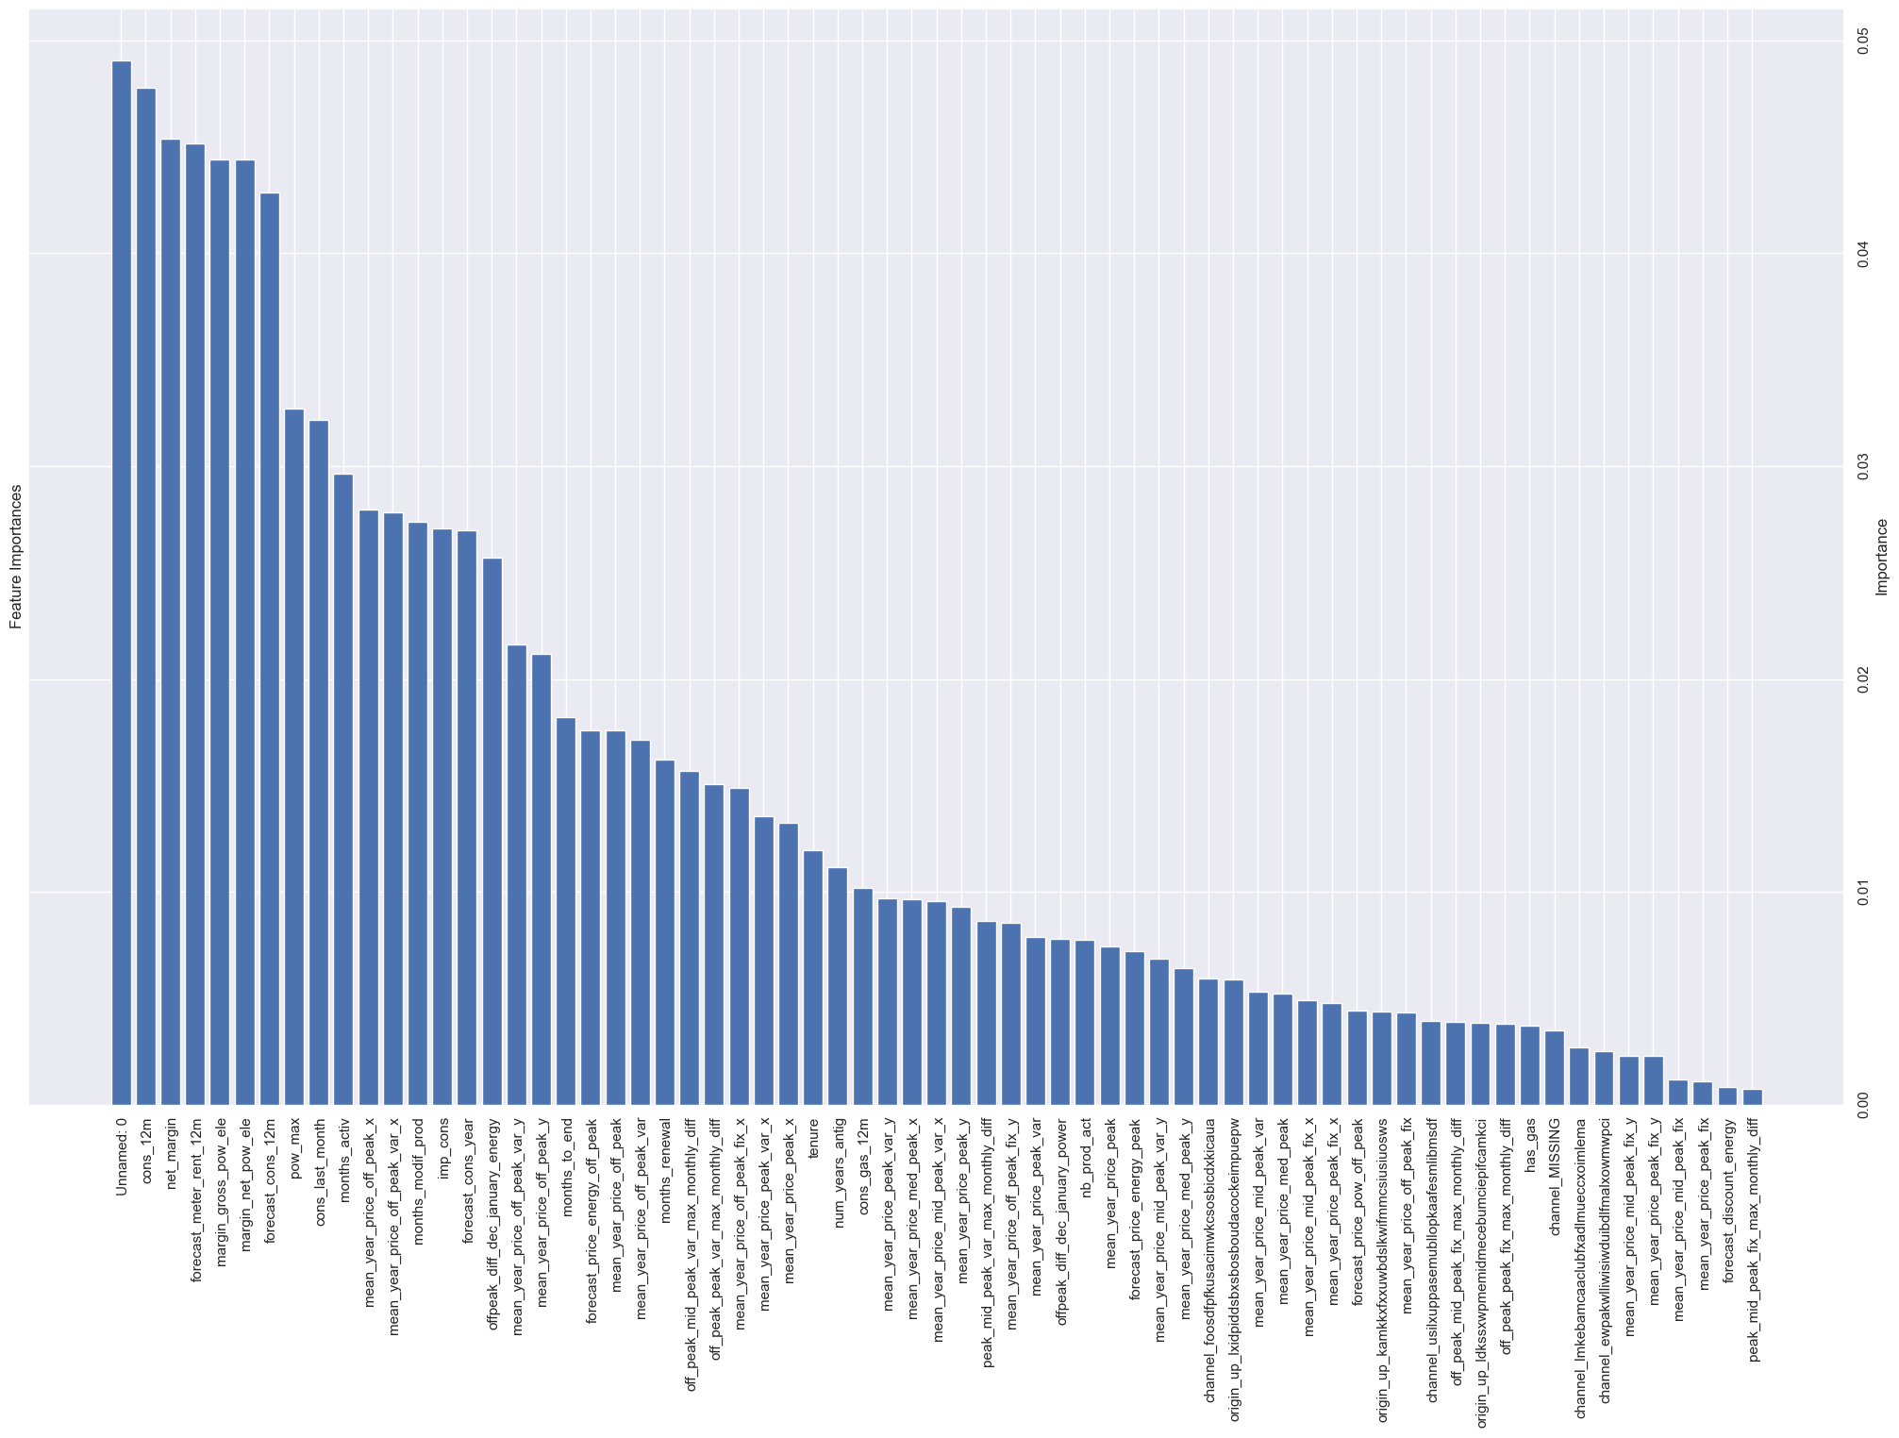
Impact of various features on the model

Slide 4
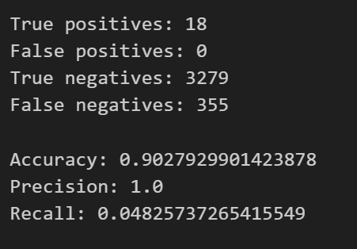
The model’s performance

